Slide 1

Design and Implementation of University Course Automatic Scheduling System Based on Genetic Algorithm
2025/26 Academic Year Graduation Project Defense
Presenter
Student ID
Boyang Ma
14548822
Supervisor
Date
Mark Elshaw
Xinyan Yu
April 2026
Communication University of China | Hainan International College

Slide 2

Research Background and Motivation
The Complexity of UCTP
Media University Pain Points
University Course Timetabling Problem (UCTP) is a classic NP-complete problem with astronomical solution spaces.
•
Diverse course types: Theory vs. Practical training.
•
Traditional manual scheduling takes weeks of effort and is highly error-prone.
Specialized venues: Studios, Recording Rooms, Animation Labs.
•
•
Lack of flexibility leads to low resource utilization and stakeholder dissatisfaction.
Strict equipment configurations and capacity limits for professional production.
•
•

Slide 3

Literature Review: Evolution of UCTP Methods
Evolution of Scheduling Methods
1960s - 1980s: Exact Methods
Gotlieb (1964): First mathematical formulation using Integer Programming.
de Werra (1985): Graph Coloring framework for conflict modeling.
Research Gap
Most existing studies focus on standard classrooms with uniform constraints.
There is limited research on:
1990s - Present: Metaheuristics
Colorni et al. (1995): First application of Genetic Algorithms to UCTP.
Srinivas & Patnaik (1994): Theoretical basis for adaptive crossover and mutation probabilities.
Specialized Media Facilities (Studios, Recording Rooms).
Real-time Diversity-based adaptive control mechanisms.

Slide 4



Problem Definition and Constraints
Hard Constraints
Soft Constraints
H1
Class Overlap
S1
Teacher Preference
No student group can attend two courses at once.
Maximize satisfaction of preferred time slots.
H2
Teacher Overlap
S2
Day Concentration
No teacher can teach two courses at once.
Minimize the number of teaching days per week.
H3
Room Capacity
S3
Room Utilization
Enrollment must not exceed room capacity.
Balance the usage across all available rooms.
H4
Room Type Match
S4
Course Concentration
Special courses must use specific venues (e.g., Studio).
Minimize gaps between courses for students.
H5
Room Overlap
S5
Optimal Room Match
No room can host two courses at once.
Best fit for room size and equipment level.

Slide 5

Algorithm Design - AMOGA Framework
AMOGA Framework Overview
Chromosome Encoding
Adaptive Multi-Objective Genetic Algorithm: Designed to handle complex constraints and multiple optimization goals.
•
One-dimensional integer array representing the schedule.
Course 1
Selection Operator: Tournament Selection (Size = 5) to maintain a balance between selection pressure and population diversity.
•
Time Slot
Room
Course 2
Time Slot
Room
Crossover & Mutation: Uniform Crossover (Rate: 0.85) and Adaptive Mutation mechanism.
...
•
Course N
Time Slot
Room

Slide 6



Main Originality: The AMOGA Innovation
Specialized Media Constraint Modeling
Real-time Diversity-based Adaptive Control
Hierarchical Fitness Landscape
Explicitly models Studios, Recording Rooms, and Animation Labs as first-class entities with equipment-specific constraints, moving beyond standard classroom scheduling.
A strict score-based boundary (Score 100) that separates feasible and infeasible regions, creating a strong evolutionary gradient driving the population toward valid solutions.
Unlike fixed-parameter GAs, AMOGA monitors Population Fitness Variance in every generation to dynamically adjust mutation rates, preventing premature convergence.

Slide 7

Core Innovation 1: Adaptive Parameter Control
Overcoming Premature Convergence
Control Logic
Traditional GAs often get trapped in local optima due to fixed mutation and crossover rates.
•
Low Diversity (< 0.001)
System detects local optima. Mutation rate is increased by 1.5x to promote global exploration.
Proposed solution: A dynamic regulation mechanism based on Population Fitness Variance.
•
Real-time monitoring of diversity allows the algorithm to switch between Exploration and Exploitation.
High Diversity
•
System focuses on refinement. Mutation rate is decreased by 0.9x to accelerate convergence.
Key Benefit
Maintains a healthy balance throughout the evolution process, ensuring robust search performance.

Slide 8

Core Innovation 2: Hierarchical Fitness Function
Strict Layered Evaluation System
Mathematical Logic
Priority 1: Hard Constraint Satisfaction
Absolute priority is given to feasibility. Any violation of H1-H5 triggers a severe penalty, ensuring the algorithm focuses on finding a valid solution first.
INFEASIBLE STATE (H > 0)
Fitness = 100 / (H_violations + 1)
Priority 2: Soft Constraint Optimization
Result: Score is always < 100
Once feasibility is achieved, the algorithm shifts focus to optimizing quality metrics (S1-S5) and resource utilization rates.
FEASIBLE STATE (H = 0)
Fitness = 100 + Soft_Score + Resource_Util
Result: Score is always > 100
This Hierarchical Pressure creates a strong gradient in the fitness landscape, preventing the algorithm from wasting cycles on high-quality but infeasible schedules.

Slide 9



System Architecture and Implementation
Vue.js
ECharts
Responsive web interface with interactive data visualization dashboards for
PRESENTATION
schedule management and algorithm monitoring.
Spring Boot
RESTful API
Core AMOGA scheduling engine encapsulated as a microservice. Handles
SERVICE
complex combinatorial optimization tasks.
MySQL
MyBatis
Relational database for persistent storage of course data, room configurations, and
DATA
generated timetables.
Real-time Convergence Monitoring
Parameter Sensitivity Analysis
Interactive Manual Adjustment

Slide 10

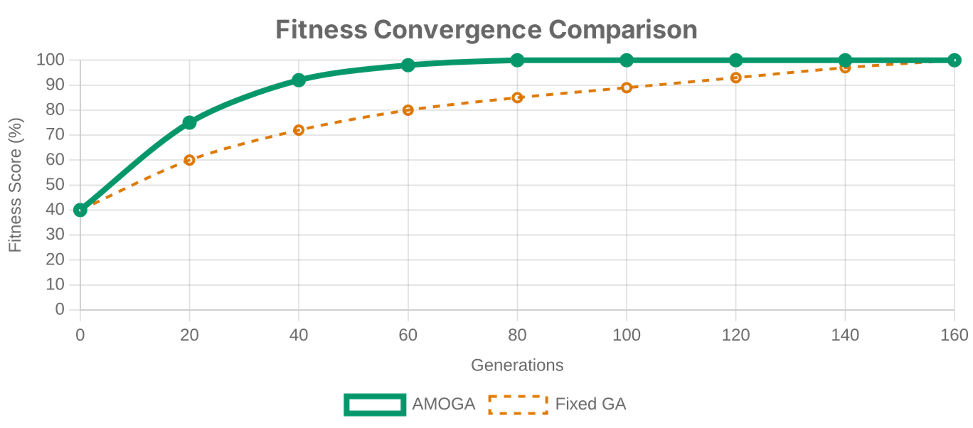
Results: Convergence & Efficiency
42.9%
Faster Convergence
Reduction in generations compared to Fixed GA.
8,920ms
Execution Time
27.7% improvement in processing speed.
AMOGA achieves stable convergence in 89 generations, significantly outperforming SA and PSO in medium-scale scheduling tasks.

Slide 11

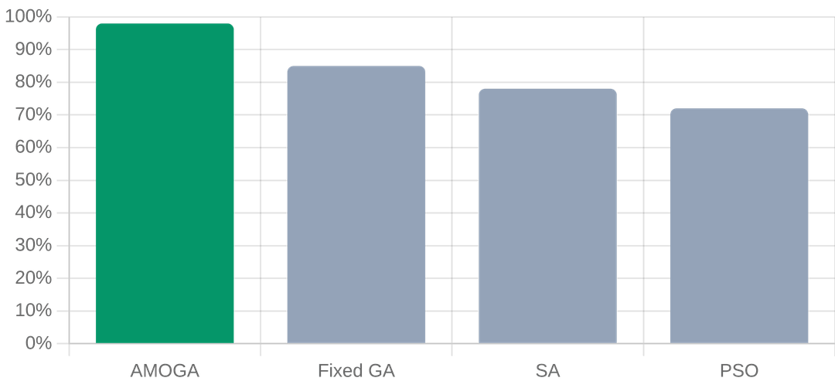
Results: Constraint Satisfaction
Hard Constraint Success Rate
Soft Constraint Optimization
+36.3%
+48.5%
Total Soft Score
Day Concentration
✔
Teacher preference satisfaction significantly improved.
✔
Balanced room utilization across specialized venues.
AMOGA achieves a 98% success rate in finding feasible solutions, ensuring 100% elimination of time conflicts for classes, teachers, and rooms.
✔
Scalable performance across various problem sizes.

Slide 12


Slide 13



Conclusion and Future Work
Core Contributions
Future Directions
Developed a specialized scheduling model addressing the unique constraints of Media Universities.
Distributed Computing: Leverage GPU/Multi-core acceleration for ultra-large scale data processing.
Proposed the AMOGA algorithm with adaptive parameter control to overcome premature convergence.
Deep Reinforcement Learning: Integrate DRL to automatically learn optimal mutation and crossover strategies.
Implemented a production-ready Web-based system with real-time monitoring and visualization.
Intelligent Interaction: Mobile integration for real-time schedule notifications and feedback.
Thank You for Your Attention!

